Slide 1
Green Industrialisation
Development Dialogue
Gaylor Montmasson-Clair & Muhammed Patel
March 2025

Slide 2
Overview
  A global transition to low-carbon development pathways is underway
    Initially driven by climate imperative, policy and the urgency of climate action to mitigate GHG emissions
    The transition is increasingly driven by market forces, as ‘greentech’ become more competitive
  These dynamics require South Africa to adapt and respond, capitalising on opportunities
    SA should protect domestic interests, particularly to ensure a JT, enhance economic and population resilience to (climate) shocks.
    SA must also secure its role in the global economy through increasing green competitiveness
  Balancing act: a) maximize the benefits of the transition, b) minimize the transition risks, and c) manage short-term trade-offs and threats in line with domestic capabilities.
  SA is highly integrated into the global political economy and has committed to achieving the Paris Agreement
  The country is also facing significant biophysical and transition impacts, from increased droughts, flooding and temperatures to the phase-out of the use of coal or internal combustion engines

Slide 3
Transition context
Growing pressure to decarbonise is interpreted differently by stakeholders - some resistance from countries, firms and individuals threatened by the transition, (e.g. fossil fuel industry)
Dominant emitters are not shifting rapidly enough and emissions inequality
  The USA, the EU and China have accounted for 60% of emissions vs 3% for Africa
  The richest 1% of humanity is responsible for more GHG emissions than the poorest 66%
  These tensions are anticipated to grow
Climate impacts are set to exacerbate poverty in the Global South, especially in Africa.
While Africa is only responsible for a marginal GHG emissions, it faces direct climate impacts that put large numbers of people and economic activities in jeopardy
  Rising temperatures, extreme weather events
  Extremely low levels of resilience
  Inadequacy of support from the Global North
  At the local level, vulnerable communities and businesses, unlike high-income households and large corporations, are similarly unable to withstand and/or adapt to external (climate) shocks

Slide 4
Driving inequality
Inequality is anticipated to rise in an un-managed transition with offensive-defensive policy by global powers, closing the gap for African economies to tap into green transition opportunities and re-shaping geopolitics and global value chains
  Green Industrial Policy (e.g. US Inflation Reduction Act, EU Green Deal Industrial Plan)
  Locking in intellectual property (through patents)
  Securing critical minerals
  Green protectionism (e.g. CBAM)
Transition impacts linked to shifts in policy, trade patterns, and technology are leading to many economic activities radically transforming or declining.
This is putting substantial pressure on people, businesses and communities relying on such activities, many of whom have low levels of resilience to shocks
The result are calls for a JT, within national economies as well as between countries, to support vulnerable stakeholders
UNFCCC initiated a JT Work Programme at COP27 in 2022.
Global North nations have struck Just Energy Transition Partnerships (JETPs) with many low- and middle-income countries to direct financial support to JT activities.
Many countries, like South Africa, have put significant emphasis domestically on the imperative of a just transition, particularly in the coal value chain.

Slide 5
Domestic context assessment
South Africa faces a unique set of challenges
  MEC supported by cheap, highly polluting, coal-based electricity and energy-intensive industries
  high levels of poverty, inequality and unemployment based on a legacy of historically-skewed economic participation has entrenched
South Africa’s emissions profile results from coal-reliance
  Most of SA’s electricity still originates from coal-fired power plants which sets a carbon-intensive base for manufacturing
  Coal also feeds the production of liquid fuels and petrochemicals through Sasol’s Coal-to-Liquid process, and steel making and cement production
  Other industries (e.g. Aluminium) have developed on the back of historically cheap electricity

Slide 6
Domestic context assessment
Some efficiency but still energy-intensive
  Rises in energy efficiency have been driven in part by rising electricity tariffs
  Economy remains energy-intensive
  For e.g. low numbers of ISO 50 001 (energy management) certifications in the country
Emissions are concentrated
  Eskom (39%) and Sasol (14%) dominate the emissions landscape, followed by companies in mining, cement, metals and forestry (ArcelorMittal ranks 3rd (< 3%))
  Most firms are reliant on such core companies for their energy and other key inputs
Transport modes also align with a given emissions profile
  Domestic transport heavily oriented towards road transport with associated costs (high emissions intensity + road externalities)
  Despite sizeable rail capacity, this mode is underutilised
  International tourism relies on depends on carbon-intensive long-haul aviation

Slide 7
Domestic context assessment
Why does this matter?
  Carbon imbibed into production and exports
  SA is a leading exporter of carbon which places us at risk for climate and trade policy in key trade partners (e.g. CBAM)
  Proximal VCs at threat include iron and steel, aluminium with challenges for domestic VCs to pivot
  Shift to ‘greentech’ will also impact numerous other industries, e.g. automotive and liquid fuel VCs or agricultural VCs (fossil fuel-based chemical fertilisers)
This also leads to employment vulnerabilities in key VCs
  Coal VC directly supports over 150 000 people in mining, power generation, petrochemicals, transport, capital equipment and services (Mpumalanga concentration)
  About 250 000 mechanics will require re-training and up-skilling to service EVs (~1/3 informally or self-employed)
  Petrol stations across the country, with some 140 000 workers, face a slow but almost certain decline in the coming decades
  The platinum VC directly employs more than 180 000 people, especially in the North West, is also at risk from the rise of EVs and the decline of catalytic converters
  The agricultural VC employs ~785 000 people in industrial agriculture, 300 000 in food processing and 80 000 in the production of wine and other alcoholic beverages

Slide 8
Green Shoots
SA has initiated a move towards lower carbon production
  Increasing focus on sustainability in previous IPAPs (RE and energy decarbonisation), NGP and NDP
  More recently, varying emphasis on sustainability in Master Plans
  Green Industrialisation features strongly in South Africa’s Just Transition policies (JT Framework, JET-IP)
  The approach has used a mix of taxes, subsidies and regulatory approaches
Where are the green shoots?
  Energy efficiency – improvement in the past 20 years – rising electricity tariffs, 12l tax incentive, efficiency standards, appliance labelling, certification and accreditation, research and development (R&D) funding, Demand Side Management programmes and education, information and awareness campaigns
  RE rollout - ~11GW of RE since 2011 through REIPPPP however challenges around SE criteria (LC), grid capacity. Exemptions since 2021 have opened up private generation significantly - ~7GW of private registrations with NERSA
  A tax incentive was also introduced but most households cannot access RE and lack of local content has increased imports
  Carbon tax + budgets – Tax introduced in 2019 with wide coverage but too low to change behaviour (currently ~R190/tonne CO2e) and exemptions lower the rate significantly. The trajectory seems to underperform expectations for emerging markets

Slide 9
Green Shoots
  Circular initiatives – EPR regulations driving sustainable end-of-life management. Packaging, electrical and electronic equipment, batteries, oil, paint, lighting, and tyres are covered - include a ban on landfill on tyres and certain plastics. EPR hampered by constraining legislation (for waste re-use), restricted sectoral coverage, the limited end-of-life management infrastructure (recycling)
  Levies – complement EPR including plastics, incandescent lightbulbs and motor emissions
  Overarching green industrialisation plan
    While a number of cross-cutting industrial policy tools are available, no dedicated policy support for greentech manufacturing value chains exists
    Some SEZs have actively pursed green strategies to provide a low-carbon business environment and attract manufacturers of green products
  Demand-side stimulus requires greater focus
    Room for tools such as green public procurement and local content in incentives
    Some SEZs have actively pursed green strategies to provide a low-carbon business environment and attract manufacturers of green products

Slide 10
Green Shoots
  R&D – an important driver of green industrialisation and JT. R&D expenditure remains < 1.5% of GDP target, at 0.6% in 2020/2021, despite a long-standing tax incentive (Section 11D of the Income Tax Act
  Development of green skills remains limited and global competition for skills. However strong emphasis through the development of some VCs (e.g. green H2)
  Targeted sector strategies
    Electric vehicles - some supply-side support for automotive value chains to transition introduced through the APDP
    More action required both on the supply and demand sides, including a targeted EV policy programme to maintain the competitiveness of the VC
    RE – SAREM aims for industrialization of the VC (RE and battery systems) and reduce the import intensity of key inputs (e.g. solar panels, mounting structures)
    Green hydrogen – important for hard-to-abate VCs and create a new export commodity, with linkages to iron and steel, aviation, fertilizer

Slide 11
Areas for policy focus
Strategy
Review of all existing masterplans for green industrialization focus
Fast-track implementation of existing plans (e.g. SAREM, EV White Paper) and complete additional ones (e.g. Water and Sanitation Industry Masterplan, Critical Minerals Masterplan) with relevant departments
Industrial finance
Phase out fossil fuel subsidies and direct funding to ‘green’ industrial policy tools
Ring-fencing revenues from taxes and levies for use in green industrialisation activities
Procurement
Draft green procurement policy and initiate trial period
Include localisation conditions in line with the Preferential Procurement Act
Launch consumer awareness campaigns targeting corporate and individual markets

Slide 12
Areas for policy focus
Carbon pricing
Progressive increase in carbon pricing in line with global norms and decarbonisation imperatives
Consider flexible designs that would retain proceeds in South Africa
NRCS to introduce mandatory standards and increase capacity of SARS to police and enforce them to limit sub-standard imports
Finalise regulations and implementation frameworks (e.g. biofuels, cleaner fuels)
Bolster support for certification (e.g. ISO 14 001 and 50 001)
Standards/ certification
Trade
Conclude ongoing ITAC investigation into RE and battery value chains and initiate new investigations as necessary (e.g. BEVs)
Streamline process for tariff application and review
Engage secretariats (e.g. AfCFTA) to map global demand for sustainable goods and services

Slide 13
Areas for policy focus
Energy
Fast-track public procurement of RE/BESS, along with the transmission rollout, curtailment framework and the market infrastructure (e.g. trading and wheeling)
Design and implement a standard, nationwide SSEG framework at the municipal/Eskom level
Transport
Fast-track implementation of the Roadmap for the Freight Logistics
System in South Africa, especially in terms of road-to-rail modal shift
Waste Management
Review waste material classifications for sustainable materials that face barriers and/or are incorrectly classified
Enforcement of EPR regulations and consideration of major categories of waste beyond current categories
Streamline licensing and permitting to reduce time and other costs, encouraging investment.

Slide 14
Areas for policy focus
Small Business
Expand support for supplier development and OEM-led industrial clusters in ‘green’ VCs (e.g. RE/ battery)
Increase technology development and commercialisation finance
Development of a dedicated policy support package for workers in transition (e.g. coal value chain)
Develop value proposition for diversified investment in just transition hotspots, including dedicated incentive framework
Develop a decent work framework linked to public procurement and state support
Just Transition
R&D
Progressively increase R&D expenditure to achieve 1.5% of GDP, with increased focus on ‘green R&D’
Establish platform to de-risk the cost of assessing and trialling local innovations in both the public and private sectors
Recapitalise the mothballed Manufacturing Technology Centre and establish new centres

Slide 15
Thank you!

Slide 16
Backup slides

Slide 17
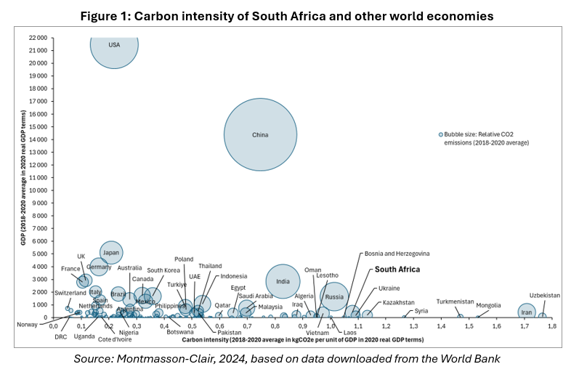
Domestic context assessment

Slide 18
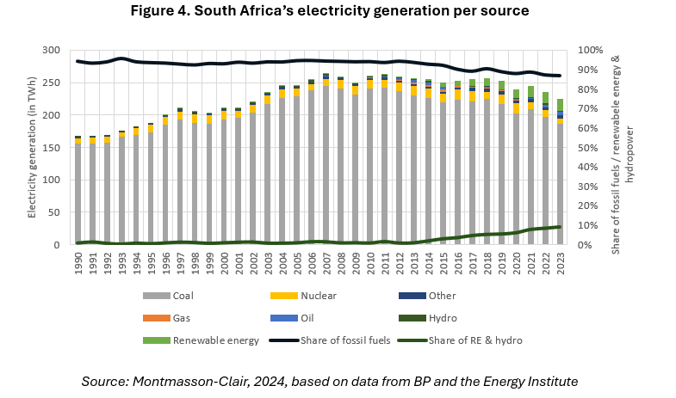
Domestic context assessment

Slide 19
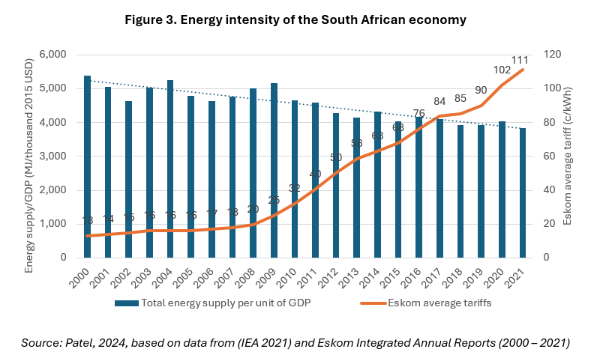
Domestic context assessment

Slide 20
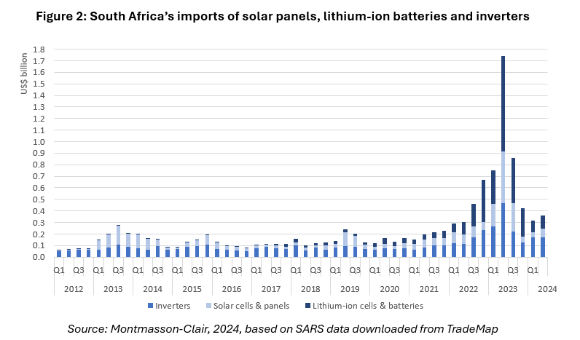
Domestic context assessment

