Slide 1
Women’s economic access and the limitations of “men in hard hats” industrial policy.
TIPS Development Dialogue: Gendering industrial policy
Nokwanda Maseko
August 2024

Slide 2
Context
  Post-apartheid industrial policy entrenched exclusion started pre-1994
  Even with overall decline in manufacturing over the years, industrial SA industrial policy remains very much about men in hard hats
    Access remains both gendered and racialised, where race is often a good indicator of location within industry and occupation
    While the Black industrial class has grown, benefits have not translated to all communities, especially among the already poor, and women
    Black women are still least likely to be in paid employment or business ownership
    When they are in employment, they are more likely to be in low-level occupations where pay is low and sometimes there are no benefits
    In business ownership, they are more likely to be in the informal sector where incomes are also low, and minimal – if any – infrastructure exists
  Minimal focus has been given to services (including social services) that support industrial policy

Slide 3
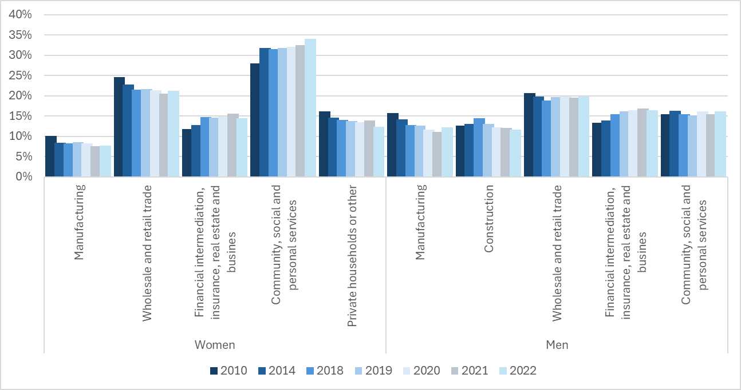
Share of employment by Industry (where employment exceeds 10%), disaggregated by gender
Source: Calculated from Quarterly Labour Force Survey data downloaded from Stats SA from https://www.statssa.gov.za/ in March 2024 using SuperWeb online facility.

Slide 4
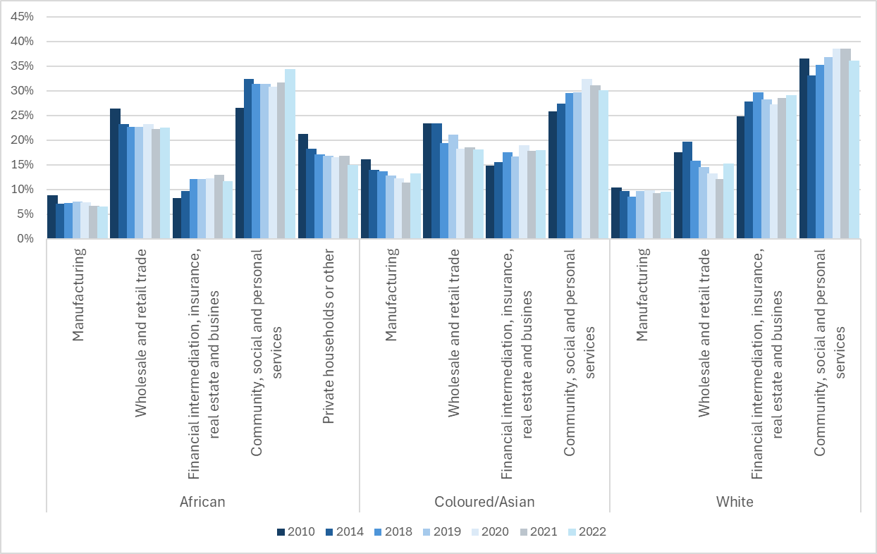
Share of women's employment by industry, disaggregated by race, 2010 - 2022
Source: Calculated from Quarterly Labour Force Survey data downloaded from Stats SA from https://www.statssa.gov.za/ in March 2024 using SuperWeb online facility.

Slide 5
Share of women’s employment in manufacturing by occupation, disaggregated by race, 2010, 2015 and 2021
Source: Calculated from Quarterly Labour Force Survey data downloaded from Stats SA from https://www.statssa.gov.za/ in March 2024 using SuperWeb online facility.

Slide 6
Small business ownership by gender and race
Source: Makgetla, N. 2023. Small business in industrial policy. TIPS Working paper
Black women’s business ownership is largely concentrated in the informal sector, though with a decline between 2010 and 2022
In the formal sector, women account for around a quarter of business ownership, but half of that is white women
Black women account for less than 15% of formal business ownership

Slide 7
Dtic incentives, 2017/18 – 2020/21
Source: DTIC Annual incentive reports 2017/19 – 2020/21
Four provinces receive almost all of dtic’s incentives, with Gauteng being the largest recipient
In part linked to the location of the automotive sector
  Automotive manufacturing has been the largest recipient of dtic incentives, followed by chemicals and pharmaceuticals – which are dominated by men, both in employment and ownership
Agro-processing and CTFL – both of which have a large share of women – received less than R700 million in 2018/19

Slide 8
Industrial policy and poor economic outcomes for women
Factors contributing to women’s poor economic outcomes
Existing inequalities make it difficult for women to participate in industrial policy without clear intervention
Women have limited asset ownership to use as collateral for private financial assistance
  This includes property ownership
    Though Black women more likely to fully own their property, but these often valued below R500k
    Location at low-level occupations also limits incomes
      More pronounced for Black women who are also more likely to be in rural areas where there is under-investment
    (Black) Women are also more likely to be in informal business ownership, where support is limited
    Time-use also a key factor, with women in unpaid or under-pain labour
SA industrial policy has continued to maintain and support industries established before or under apartheid
  Mainly heavy industries where women are under-represented
  Also maintains the spatial inequality created prior to, and under apartheid
  Both IPAP and the Masterplans gave minimal effort to prioritise women’s access in a clear way
  Neither mapped out a clear path for women’s increased participation in industrial policy
  Similar under-investment in (social) services that enable industrial policy

Slide 9
Some take-aways
Women’s access to industrial policy remains limited by a focus on “hard hats” industries
Key industrial policy frameworks never outlined how women’s participation will be increased
Instead, (Black) women are over-represented in (social) services where the state is a key employer
  But also where funding has been decreasing in real terms
  Improvement requires an all-of-government and private sector solutions to:
  Address factors keeping women from economic participation
  Increase investment in social services like education and health
  Facilitate women’s access to “hard hats” industries by utilising available industrial policy tools

Slide 10
Thank you!

