Slide 1
Development Dialogue on Developing the Renewable Energy Industrial Value Chain in South Africa
TIPS, Pretoria, 30 May 2024
What would it take to localise
the renewable energy value chain in South Africa?
Gaylor Montmasson-Clair
Senior Economist
Trade & Industrial Policy Strategies (TIPS)

Slide 2
A bumpy ride historically
South Africa’s renewable energy generation capacity (in MW)
Source: Montmasson-Clair, based on IRENA data

Slide 3
A clear acceleration in recent years
Power generation capacity registered with NERSA
under licensing exemption conditions
Installed, cumulative renewable energy generation capacity in SA (in MW)
Source: Montmasson-Clair, based on Eskom data
Source: Montmasson-Clair, based on NERSA data

Slide 4
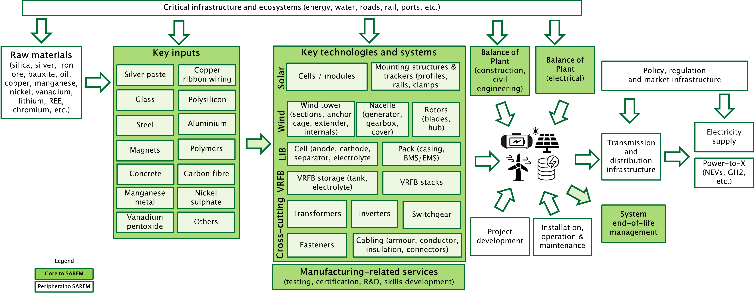
The renewable energy industrial value chain

Slide 5
An existing ecosystem of manufacturers
Solar PV value chain | Wind energy value chain | Battery storage value chain
Modules: ArtSolar, Seraphim*, Ener-G Africa | Concrete towers: Concrete Units, Nodex/WBHO, Colossus* | Mineral refining: MMC (manganese metal), Thakadu (nickel sulphate), Hulamin (aluminium foil), vanadium pentoxide (Bushveld Minerals)
Mounting structures and trackers: ModeTech, Caracal Engineering, K2 Systems, PVH, Barnes Tubing, IMAB Technologies, Lumax Energy, KD Solar | Steel towers: GRI Towers | Casings, modules and cooling: multiple steel, aluminium and plastics suppliers, machining operations and aluminium extruders (e.g., Hulamin, Wispeco).
Inverters: Rubicon (MLT), Microcare, Ario# | Primary steel: ArcelorMittal South Africa | LIB Pack assembly: Balancell, Blue Nova, Freedom Won, Hubble Lithium, Maxwell & Sparks, Polarium, Rubicon, SolarMD, Creslow Energy Solutions
Transformers: Actom, Reliable Transformers, ArmCoil Afrika, Zest Weg | Tower internals: ModeTech | BMS/EMS: Balancell, Blue Nova, Freedom Won, Hubble Lithium, Maxwell & Sparks, Polarium, Rubicon, SolarMD
Cables: Aberdare, CBI African Cables, SOEW | Anchor cages and extenders: Modetech | LIB recycling: Circular Energy, Reclite, eWaste Africa
Fasteners: CBC Fasteners, Impala Bolts & Nuts | Transformers: Actom, Powertech, Matlakse, SGB-Smit Power Matla | Second-life LIB: Revov
Combiner boxes: HellermannTyton, Weidmuller and Allbro | Fasteners: SA Bolts | VRFB electrolyte: Bushveld Energy
Switchgears: RWW Engineering and Switchgear Unlimited | Cables: CBI African Cables, M-tech, Aberdare | VRFB assembly: Bushveld Energy (Enerox)
Note: *mothballed; #awaiting certification

Slide 6
A once-in-a-century opportunity, fuelled by imports
SA’s imports of solar panels, lithium-ion batteries and inverters
Source: Montmasson-Clair, based on TradeMap and Quantec data

Slide 7
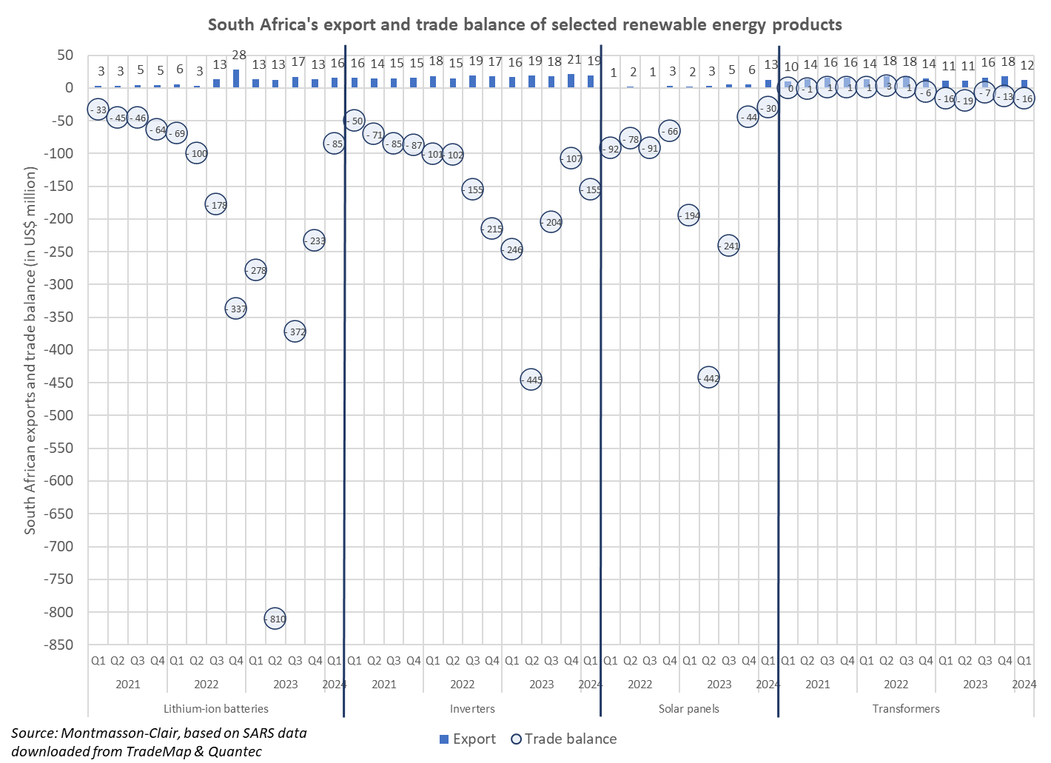
A once-in-a-century opportunity, fuelled by imports
Source: Montmasson-Clair, based on TradeMap and Quantec data

Slide 8
Localisation opportunity matrix (2030)
Big wins
LIB cells
Value added mineral products
(Mn, Ni, V, Al, etc.)
Polysilicon
Wafer & ingots
Solar cells
High stakes, high rewards
Solar modules
Tower (concrete)
Mounting structures and trackers
Inverters (string)
Tower internals
Step-up transformers (Solar PV)
Hubs and nacelle
Tower (steel)
Step-up transformers (Wind)
Blades
Inverters (collector)
Collector transformers (Solar PV & Wind)
LV cables
(Solar PV)
Socio-economic benefits
MV cables
(Solar PV)
LIB components
& casing
Primary steel (Wind)
Vanadium electrolyte
Fasteners
(Solar PV)
VRFB stacks
Stealing the blinds
BMS/EMS
Flexible MV cables (Wind)
Fasteners
(Wind)
Rigid MV cables (Wind)
VRFB tanks
Source: Montmasson-Clair, based on various sources and interviews
Domestic growth potential

Slide 9
Looking ahead
Stable demand, breaking away from the historical stop-start pattern, is a fundamental pre-requisite for any successful industrial development strategy
A minimum rollout of RE of 3 GW per annum, ramping up to 5 GW per annum by 2030, is necessary to underpin the development of the value chain (the PCC recommends a rollout of 6-8 GW per year of RE to achieve energy security and climate-related goals)
Compared to its peers, South Africa is considered an attractive location for manufacturing investment in the value chain.
However, the extremely competitive nature of the global RE and battery storage industry points to the need for South Africa to put forward a compelling investment case to the market.
  Ambitious supply-side support is paramount to enhance the competitiveness of locally-manufactured products.
  The broader VC ecosystem must be geared towards the development of local capacity and capabilities.

Slide 10
Demand-side dynamics
Stable demand is a fundamental pre-requisite for any successful industrial development strategy.
Market demand has, so far, been too inconsistent to support industrialisation.
Enabling a smooth demand profile requires a consistent rollout of across market segments
Ambitious large- and small-scale public procurement (REIPPPP, ESIPPPP, SOEs, government depts, municipalities, etc.) and rollout (public structures, un-/under-served communities and households)
Medium- and large-scale private sector procurement
Small-scale residential, community and commercial/industrial rollout
Public sector procurement and policy support haven been insufficiently or inadequately connected to localisation objectives.
1) Demand
2) Demand
3) Demand
Cross-cutting issues still hinder demand
Physical infrastructure (grid rollout and optimisation mechanisms)
Policy and regulation, including market infrastructure
Financing mechanisms for industrial, commercial and farming operations, but also households and communities
Alternative models for low-income households and community-owned systems
Develop ‘downstream’ demand drivers (power-to-x markets)

Slide 11
Demand-side dynamics
SA's imports of solar cells, modules & panels
SA's import of wind turbines (in US$ millions)
Source: Montmasson-Clair, based on TradeMap and Quantec data

Slide 12
Supply-side considerations
In a highly competitive global environment, securing manufacturing in the RE and battery storage value chains must be underpinned by a compelling value proposition
Most countries seeking to attract investment in green industries have offered substantial supply-side support in the form of grants, tax incentives and concessional funding
Tax incentive for manufacturing investment in ‘greentech’ (e.g. 12i) to complement existing measures
SEZ value proposition, incl. incentives, Customs Clearance Areas and zero-rated VAT / duties
Enhanced testing and certification, esp. for batteries, solar panels, inverters, transformers, cables and fasteners
Strategic use of trade instruments
Import duty exemption or protection on strategic inputs
Enforcement of custom duties and mandatory quality standards on imported goods to prevent the entry of sub-standard products as well as the circumvention of existing tariff protection.
(Regional) value chain deepening
Strategic partnerships (SADC, BRICS, AU), particularly in the battery value chain
Alignment with connected industries (e.g. mining/beneficiation, steel/aluminium, autos, end-of-life management)

Slide 13
Cross-cutting ecosystem dynamics
Building the skills on the back of a demand-led approach
Match-making ‘PowerUp’ platform between education & training providers and industry
Standardised trainings & qualifications
Pathways from ‘learning’ to ‘earning’ (e.g. Yes4Youth)
Recognition of Prior Learning
A heightened focus on supplier development and technology readiness would unlock substantial support for new entrants and emerging suppliers
OEM-led cluster platform linking the different parts of the value chain (OEMs, Tier 1 and Tier 2 companies) to support supplier development, along with the dtic’s Strategic Partnership Programme
Transformation Fund to support new entrants
Increased focus on technology commercialisation
Access to machinery, equipment and expertise (e.g. Manufacturing Technology Centre)
Mechanisms & platforms to de-risk trials and ‘localise’ new technologies
Drive an inclusive value chain
Decent work framework linked to public procurement and state support
Gender inclusivity action plan
Clear guidelines and best practice for ESOPs + pilot programmes
B-BBEE sector specific scorecard

Slide 14
In closing...
Source: Montmasson-Clair, based on TradeMap and Quantec data
Source: Bloomberg, 2024
Notes:
SA: 24th by population; 40th by GDP; 22nd in electricity production, 41st by manuf output

Slide 15


Trade & Industrial Policy Strategies
Supporting policy development
through research and dialogue
www.tips.org.za
Gaylor Montmasson-Clair
Senior Economist
gaylor@tips.org.za
+27 12 433 9340 / +27 71 31 99 504
| @Gaylor_MC

